Slide 1
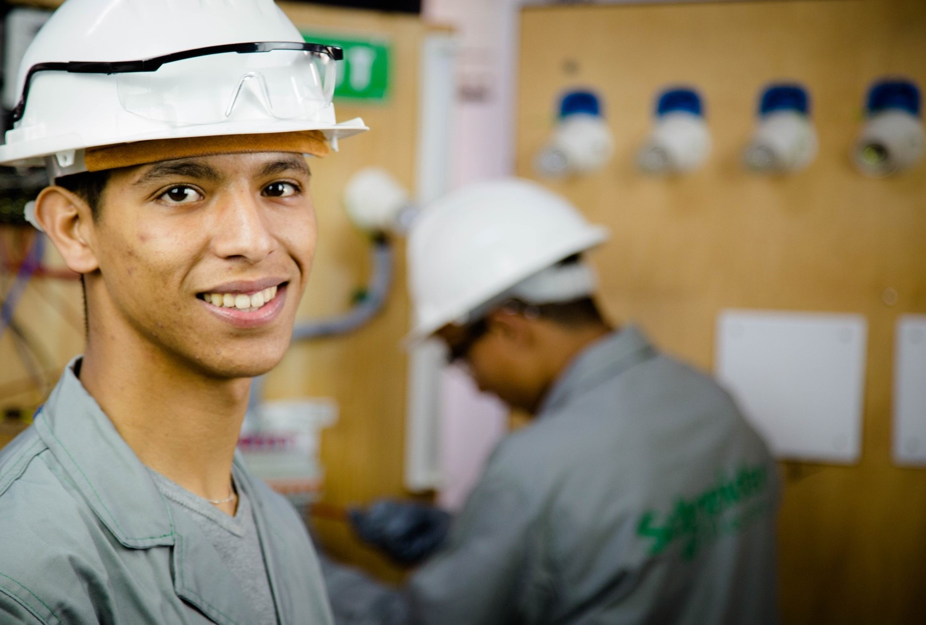

INSTITUT EUROPÉEN DE COOPÉRATION ET DE DÉVELOPPEMENT
Who are we? Entrepreneurs in human and economic development training
the responsible stakeholders of the future

Slide 2
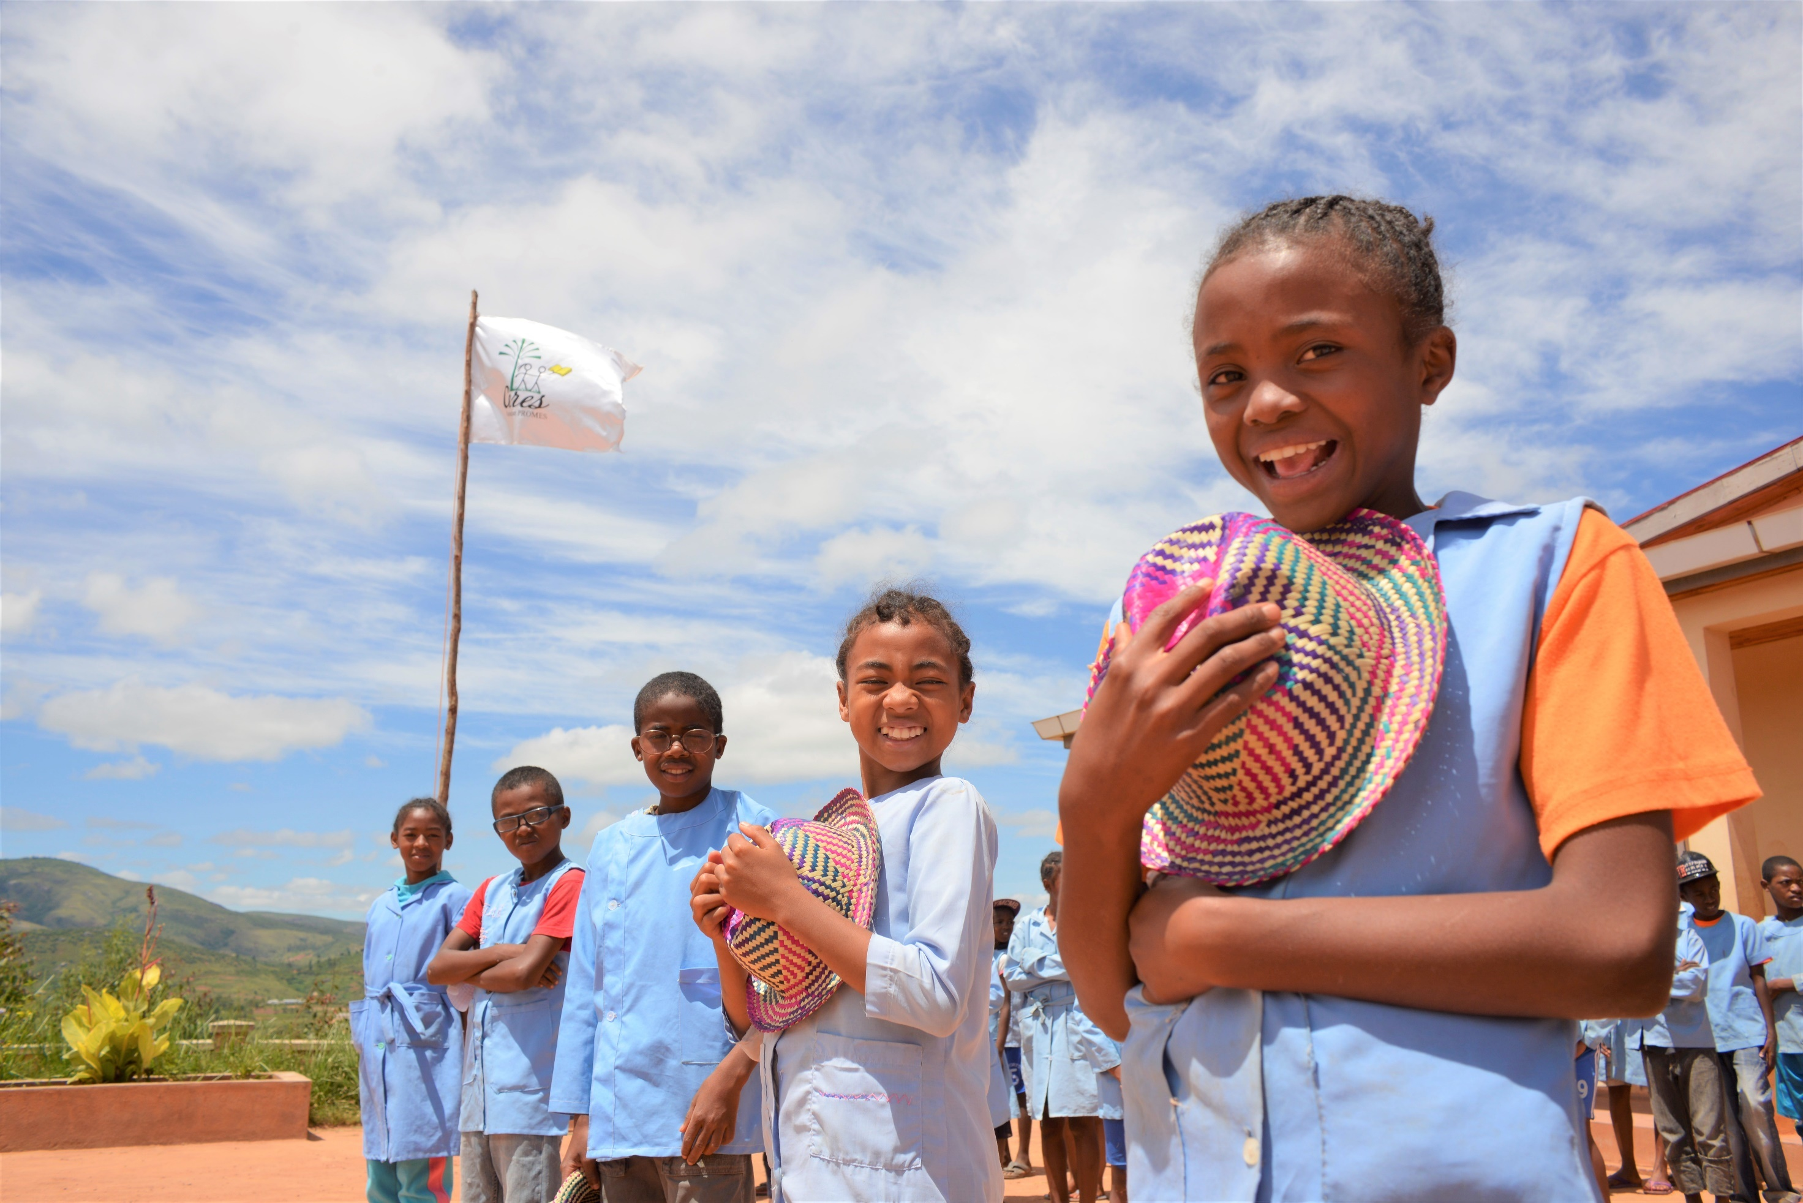

Our mission? To create environements which allow every individual to build its future
and a more equitable society

Slide 3
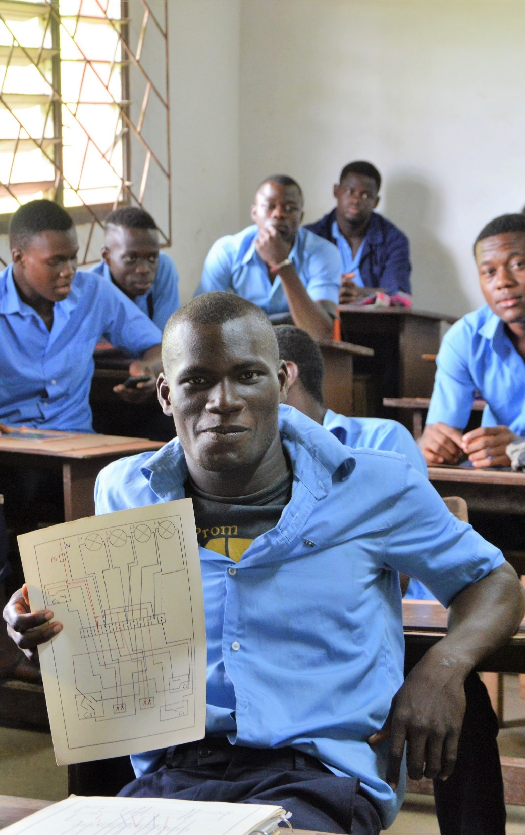
A French international solidarity organisation recognized of public-interest
An expertise of 30 years
52 projects implemented over15 countries
4 core actions (vocational training and employment for youth, entrepreneurship, education, healthcare)
More than 23,000 children, teenagers, young people and adults trained and employed
More than 74,000 patients taken care of or benefiting from beter quality healthcare

Slide 4
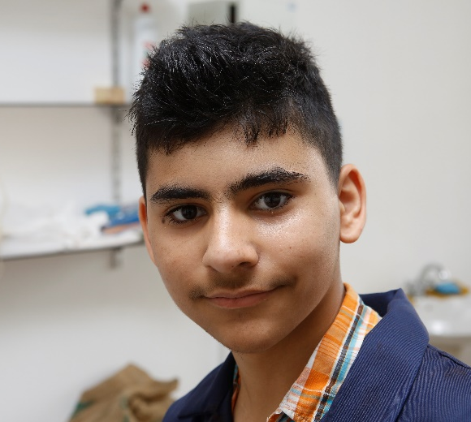
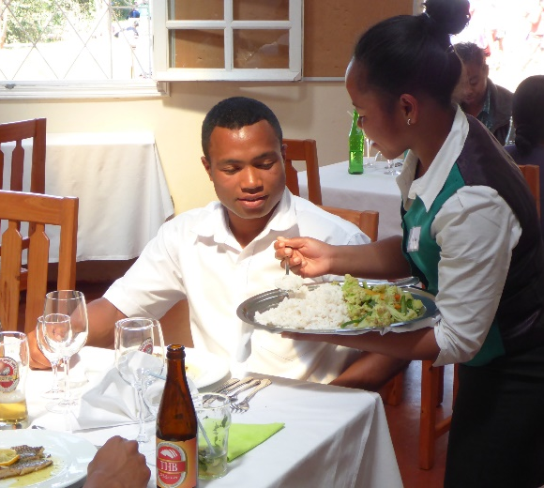
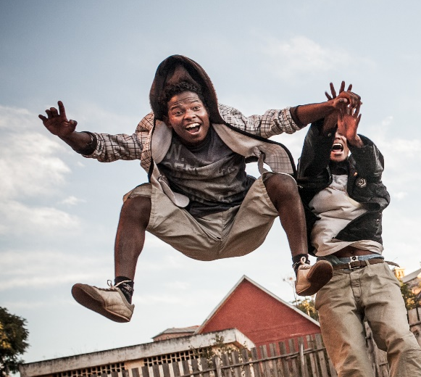
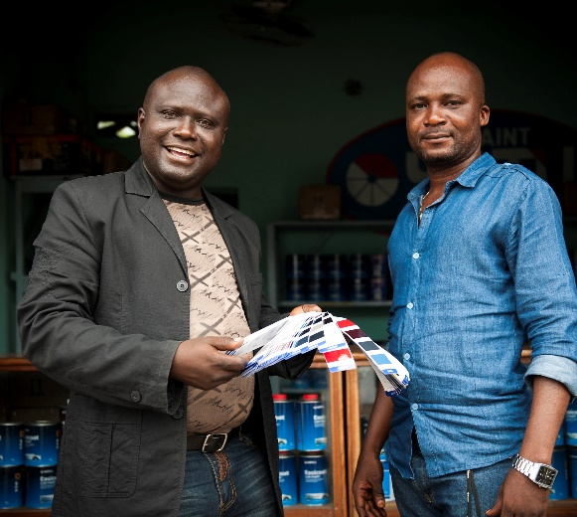
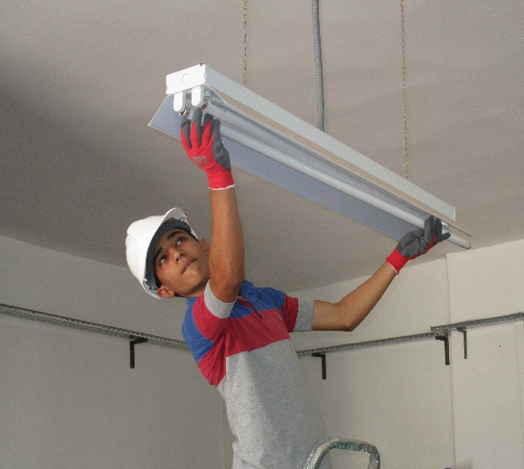
A focus on the person
A spirit of service
The daring to undertake
A professional commitment
The patience to implement
3 VALUES…
…2 VIRTUES

Slide 5
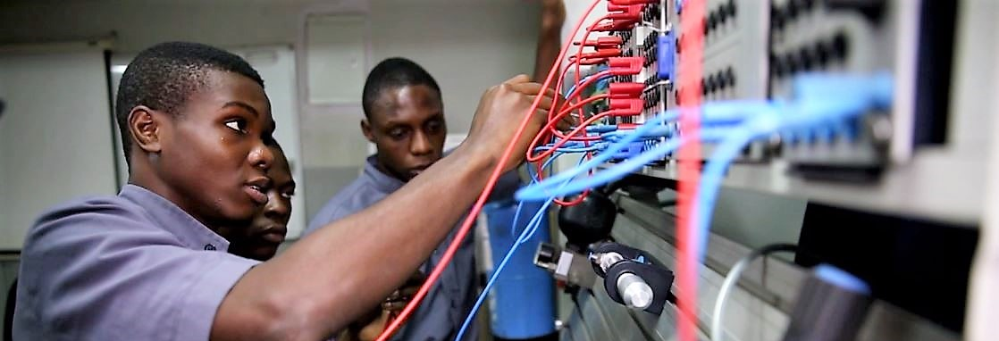
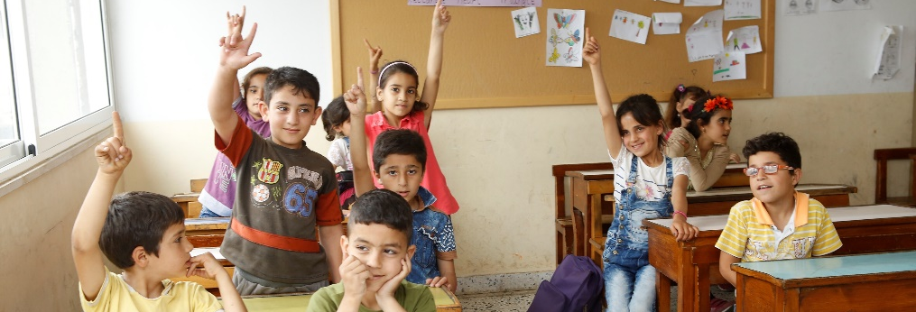
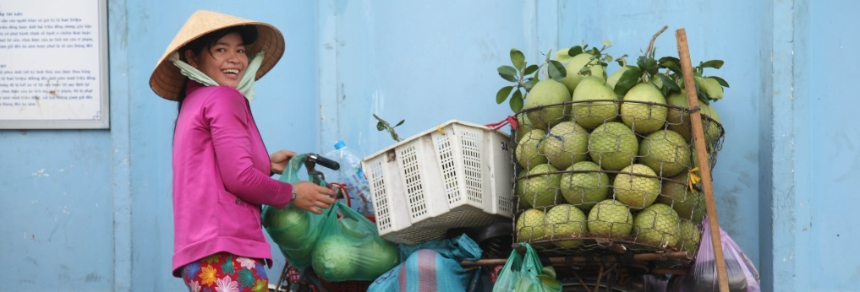
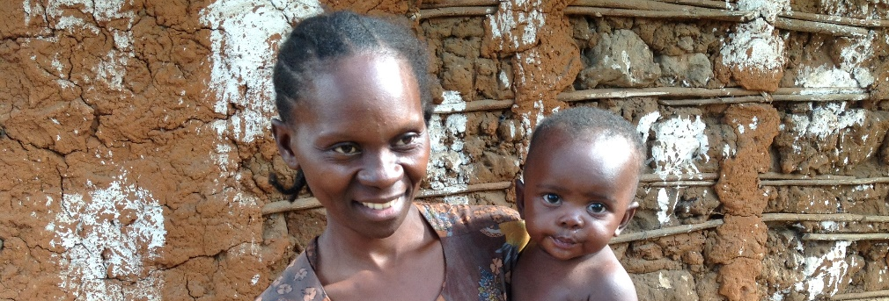
young people trained and employed
children and teenagers in schools
small businesses supported
mothers and children
12,000
4,000
4,000
3,000
taken care of
71,000 people benefiting from better quality health care
THE BENEFICIARIES

Slide 6
VOCATIONAL TRAINING AND EMPLOYMENT
- SEEDS OF HOPE (SOH) Training for careers in INDUSTRY, ENERGY AND MAINTENANCE.
- FAMILY FARM SCHOOLS (FFS)
- Training for careers in HOSPITALITY-CATERING
- SPECIFIC TRAINING AND SHORT TRAINING COURSES – Various sectors
- ACCESS TO EMPLOYMENT
ENTREPRENEURSHIP
- SUPPORT TO SMALL URBAN ENTERPRISES
- RURAL ENTREPRENEURSHIP
EDUCATION
- EDUCATION AND REMEDIATION STRENGTHENING (CERES-SESAME)
- ACTIONS FOR REFUGEES and FOR PEOPLE WITH DISABILITIES
HEALTHCARE
- SUPPORT TO HEALTHCARE STRUCTURES
- IMPROVEMENT OF HEALTHCARE FOR PEOPLE SUFFERING OF SICKLE-CELL DISEASE
34%
OF THE ACTIVITY
31%
OF THE ACTIVITY
24%
OF THE ACTIVITY
11%
OF THE ACTIVITY
4 CORE ACTIONS

Slide 7





161 IECD employees in the field
Vocational training and emloyment
17
45
54 expatriates
107 local contracts
Entrepreneurship
Lebanon
Syria
Education
18%
4%
2
3
Healthcare
Morocco
Egypt
IECD employees
2%
2%
%
Operating budget
3
Palestinian
Territories
4%
4
14
Myanmar
1%
Ivory Coast
5
18%
Vietnam
Nigeria
1%
3
1
2%
DRC
Thailand
6%
3%
21
Cameroon
13%
2016
22
3
4 GEOGRAPHIC AREAS
Sub-saharan Africa, Madagascar, Middle East and North Africa, Southeast Asia
Congo-Brazzaville
21
8%
Madagascar

Slide 8
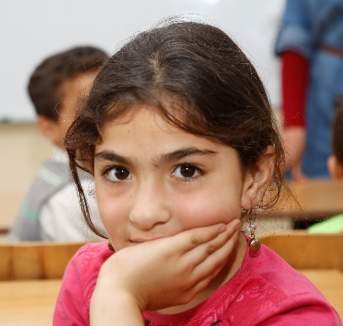
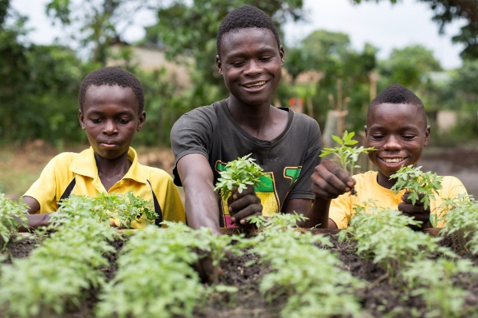
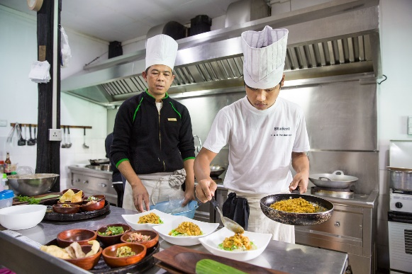
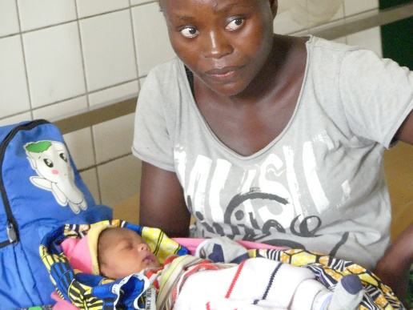
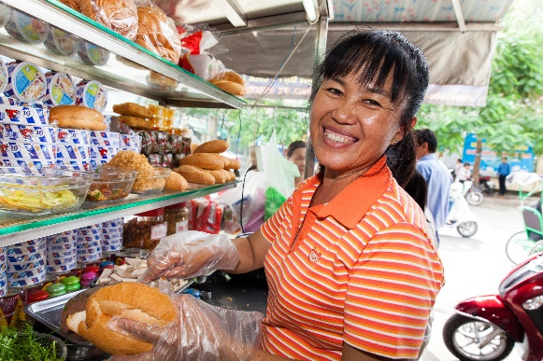
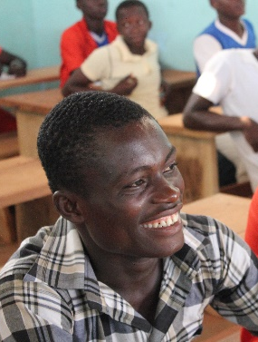
A GROWING ACTIVITY…
+ 22 %
… to serve more people in need
Operating budget
Since 2014
2014
50,000 beneficiaries
2015
80,000 beneficiaries
2016
94,000 beneficiaries

Slide 9














A strong, efficient and transparent financial management
  Through management, planning and internal control tools, technical and financial evaluation and internal and external auditing
Working Closely with committed partners
  Private funds: companies and corporate foundations, associations, philanthropic foundations, private donors
  Public funds: French institutions, the European Union, local authorities, international organisations, bilateral cooperation
  Examples
  Examples
OUR FINANCIAL RESOURCES

Slide 10
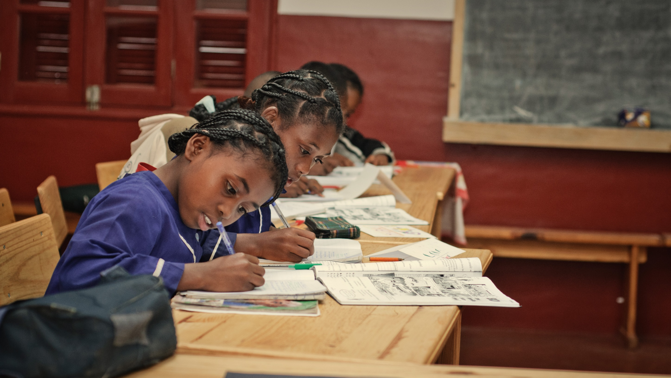

4 CORE ACTIONS

Slide 11

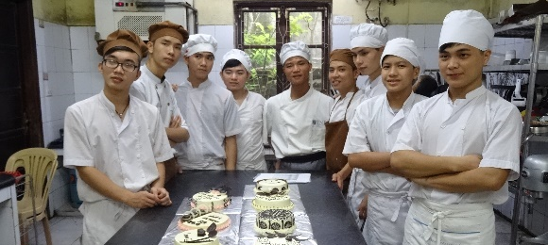
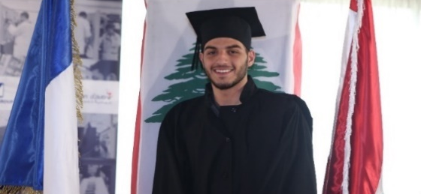
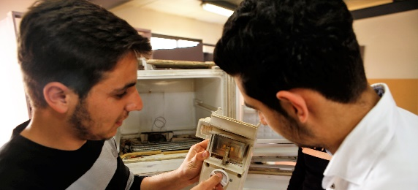
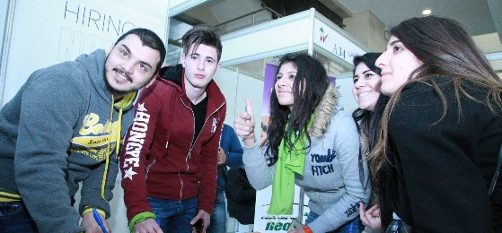

1/4 – VOCATIONAL TRAINING AND EMPLOYMENT
To promote sustainable employment for young people
34%
OF THE ACTIVITY
23
PROJECTS
12
COUNTRIES
CAREERS IN HOSPITALITY-CATERING
CAREERS INDUSTRY, ENERGY and MAINTENANCE
SHORT TRAINING COURSES
CAREERS IN AGRICULTURE
ACCES TO EMPLOYMENT
Train rural entrepreneurs
of tomorow
Train disadvantaged young people to booming careers
Gain lasting employment in the country’s dynamic industry sector
Meet the needs of population in great difficulty
Promoting access to guidance employment training
38 Family Farm Schools
3 Training Institutes for Rural Entrepreneurship.
2 Hospitality-Catering schools
3 Bread-Pastry making Schools
ASSET-H&C Regional platform
27 partner schools
Electricity, welding, computer maintenance, secretary, manicure-pedicure.
Professional integration: 19 Career Guidance Offices
3 production workshops for people with disabilities or learning disorders
Nearly 1,200 young people trained in 2016
More than 500 young people trained in 2016
Nearly 4,000 young people trained in 2016
Nearly 2,500 beneficiaries in 2016
More than 3,300 young beneficiaries in 2016
Cameroon, Ivory Coast, DRC
Thailand, Vietnam, Myanmar, Madagascar
Lebanon, Nigeria, Egypt, Morocco, Ivory Coast, Vietnam
Lebanon, Syria
Lebanon

Slide 12

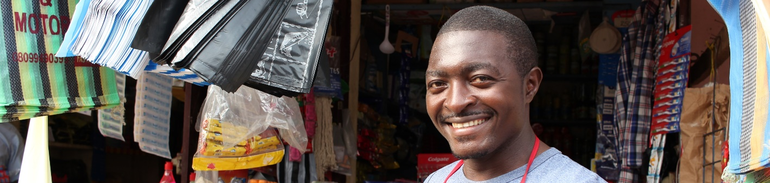
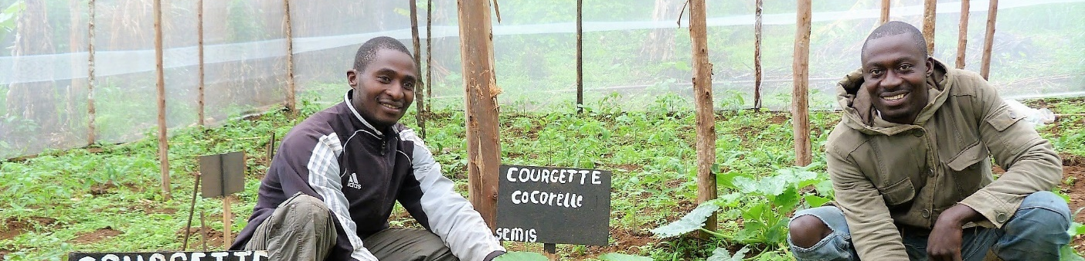
2/4 - ENTREPRENEURSHIP: to fight against poverty and enhance economic development
31%
OF THE ACTIVITY
13
PROJECTS
8
COUNTRIES
SUPPORT to SMALL ENTERPRISES
RURAL ENTREPRENEURSHIP
To assist entrepreneurs in the development of their activity
To support entrepreneurial initiatives in agriculture or agribusiness
Basic Management Training
15 Management and Services Centers(CGS) et 5 mobile units
TRANSFORM : TRANSferring capacities to Small entrepreneurs in FOod-processing, Research and Management
APONH : support to farmers
Nearly 4,000 entrepreneurs
improved their revenues and improved their living conditions in 2016
245 entrepreneurs, farmers and small food business owners trained in 2016
Cameroon, Ivory Coast, DRC, Madagascar, Congo-Brazzaville, Lebanon, Palestinian territories, Vietnam
Cameroon, Ivory Coast

Slide 13

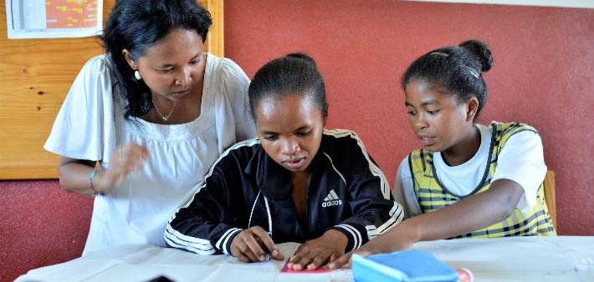
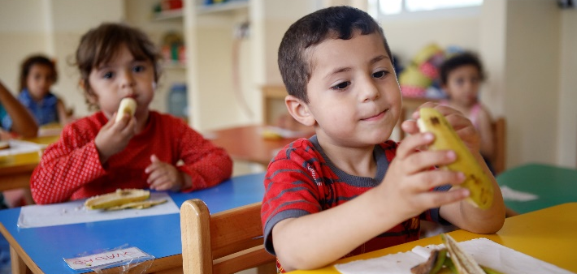
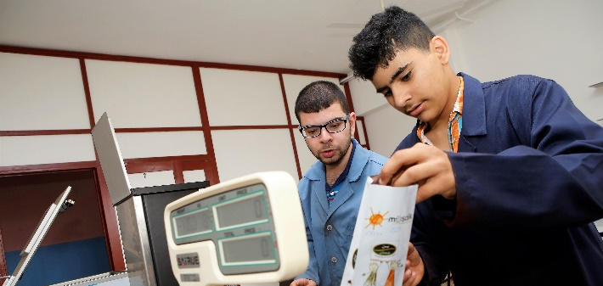
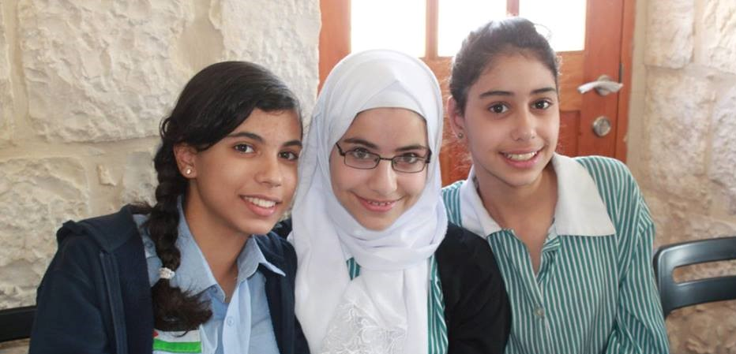
3/4 – EDUCATION: to promote access to quality education for marginalised populations
24%
OF THE ACTIVITY
9
PROJECTS
3
COUNTRIES
EDUCATION CENTERS FOR REFUGEE AND LEBANESE CHILDREN
EDUCATION FOR CHILDREN WITH SPECIAL NEEDS
THE AL HAMAWI COMMUNITY EDUCATION CENTER
CERES – SESAME PROGRAMS
Rural students affected by poverty
Young refugees who dropped out of school because of exile
Excluded and marginalised children
Young students who dropped out of school
CERES : assistance from junior school to baccalaureate
SESAME : support to bachelor degree students
3 centers : Janah, Tripoli and Al Qaa
MOSAIK special school
Trait d’Union’s training resource and guidance center
Based in East Jérusalem
Nearly 1,000 children and young people supported in 2016
More than 700 children welcomed in 2016
80 chidren benefited from the detection and care program
More than 200 children and teenagers welcomed in 2016
Madagascar
Lebanon
Lebanon
Palestinian Territories

Slide 14

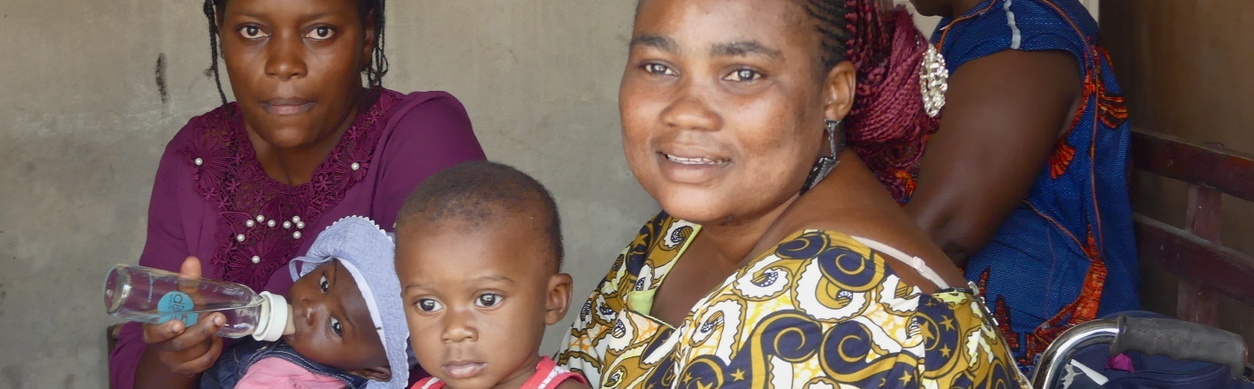
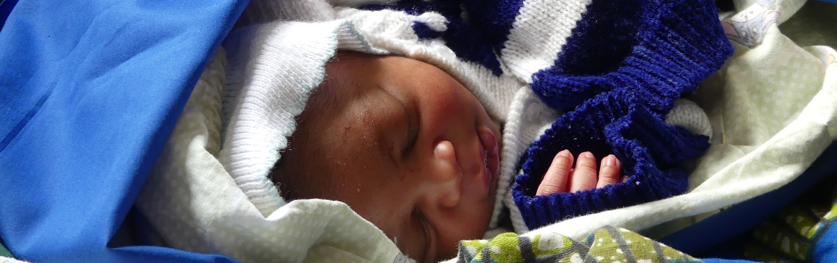
4/4 - HEALTHCARE: to strengthen health structures and improve the care for the most vulnerable patients
11%
OF THE ACTIVITY
8
PROJECTS
5
COUNTRIES
SUPPORT to HEALTHCARE STRUCTURES PROGRAM (PASS)
IMPROVEMENT OF CARE FOR PEOPLE SUFFERING of SICKLE-CELL DISEASE
To improve access and treatment
for vulnerable women and children
To improve care for people suffering from sickle-cell disease
Support to the Platform for the Protection against Sickle-Cell Disease
Capacity building for the NetworkStudy of sickle-cell disease in Central Africa (REDAC)
8 public and private healthcare centers supported
More than 71,000 people benefiting from better quality healthcare in 2016
More than 3,000 children and adults suffering from drepanocytose taken care of in 2016
Congo-Brazzaville (Pointe-Noire)
DRC, Madagascar, Cameroon, Congo-Brazzavile

Slide 15
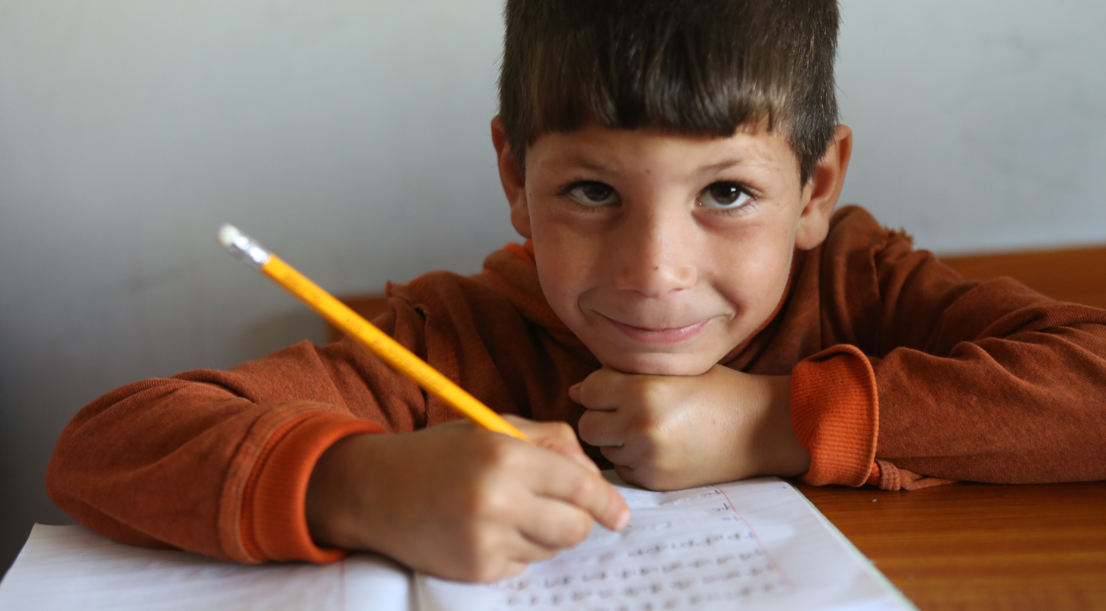
Thank you for your interest!
More information about IECD on www.iecd.org

